Slide 1


Machine Learning and Neural Network
TC2423
Siti Norul Huda Sheikh Abdullah (Phd)

Slide 2
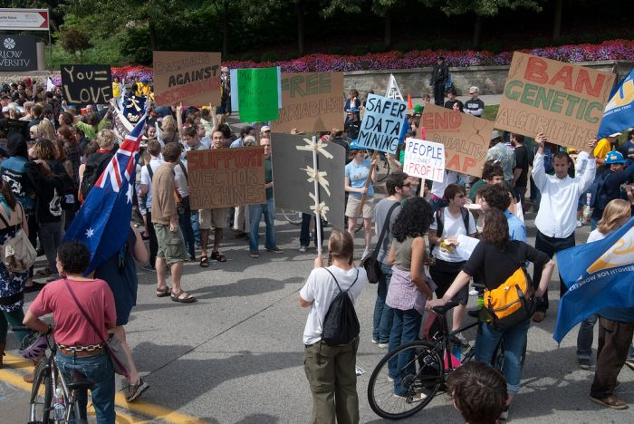
Machine Learning
Computer Vision
James Hays, Brown
Slides: Isabelle Guyon, Erik Sudderth, Mark Johnson, Derek Hoiem, Lana Lazebnik
Photo: CMU Machine Learning Department protests G20

Slide 3
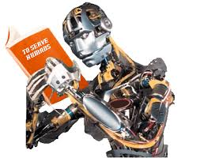
Machine Learning
Exponentially growth
Create new capability for computers
Application
character or handwritten recognition, computer vision, real time systems such as Auto-pilot, computer aided diagnosis or detection, etc
knowledge discovery or data mining is blooming due to big data, growth of automation/web records like web click data, medical records, biology, engineering etc
self customizing programs like Amazon, self-learning or product recommendations
Understanding human way of learning (brain, real AI)

Slide 4
Machine Learning: Definition
Arthur Samuel (1959): field of study that gives computers the ability to learn without being explicitly programmed.
Tom Mitchell (1998) Well-posed learning problem: A computer program is said to learn from experience E with respect to some task T and some performance measure P, if its performance on T, as measured by P, improves with experience E.

Slide 5
Think 1
A computer program is said to learn from experience E
with respect to some task T and some performance measure P,
if its performance on T, as measured by P, improves with experience E.
Suppose your email is full of jargon or spam, you wish to create a filter that can learn spam email. What would be T, P and E in this setting ?
Classifying emails as spam or not spam
You self label your spam email
How much spam emails are correctly classified as spam/not spam
This is not a machine learning problem

Slide 6
What is Machine Learning?
Machine Learning Algorithms
supervised learning
unsupervised learning
Others: reinforcement learning, recommender systems

Slide 7
Supervised Learning: Definition
Supervised learning is the machine learning task of inferring a function from labeled training data.^{[1]} The training data consist of a set of training examples. In supervised learning, each example is a pair consisting of an input object (typically a vector) and a desired output value (also called the supervisory signal). A supervised learning algorithm analyzes the training data and produces an inferred function, which can be used for mapping new examples. An optimal scenario will allow for the algorithm to correctly determine the class labels for unseen instances. This requires the learning algorithm to generalize from the training data to unseen situations in a "reasonable" way (see inductive bias).

Slide 8
Supervised Learning : Definition
A type of learning that requires an external teacher, who presents a sequence of training examples to the ANN. Each example contains the input pattern and the desired output pattern to be generated by the network. The network determines its actual output and compares it with the desired output from the training example. If the output from the network differs from the desired output specified in the training example, the network weights are modified. The most popular of supervised learning is back-propagation. (Micheal Negnevistky, 2011)

Slide 9
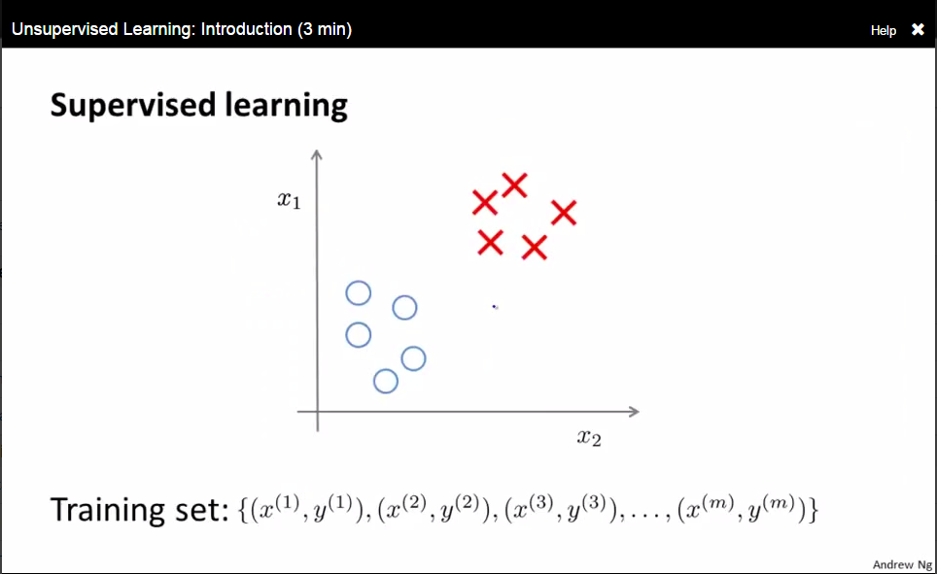

Slide 10
Unsupervised Learning
In machine learning, the problem of unsupervised learning is that of trying to find hidden structure in unlabeled data. Since the examples given to the learner are unlabeled, there is no error or reward signal to evaluate a potential solution. This distinguishes unsupervised learning from supervised learning and reinforcement learning.
Unsupervised learning is closely related to the problem of density estimation in statistics.^{[1]} However unsupervised learning also encompasses many other techniques that seek to summarize and explain key features of the data. Many methods employed in unsupervised learning are based on data mining methods used to preprocess^{[citation needed]} data.

Slide 11
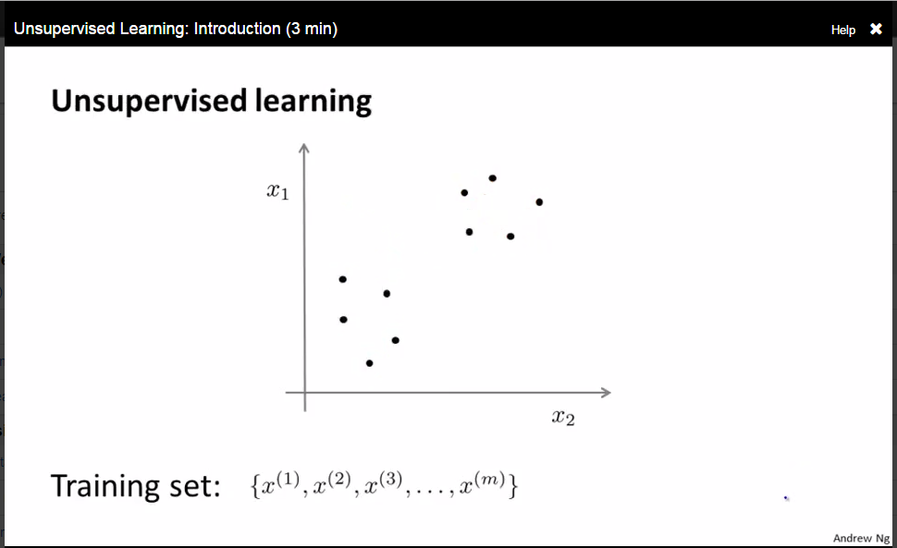

Slide 12
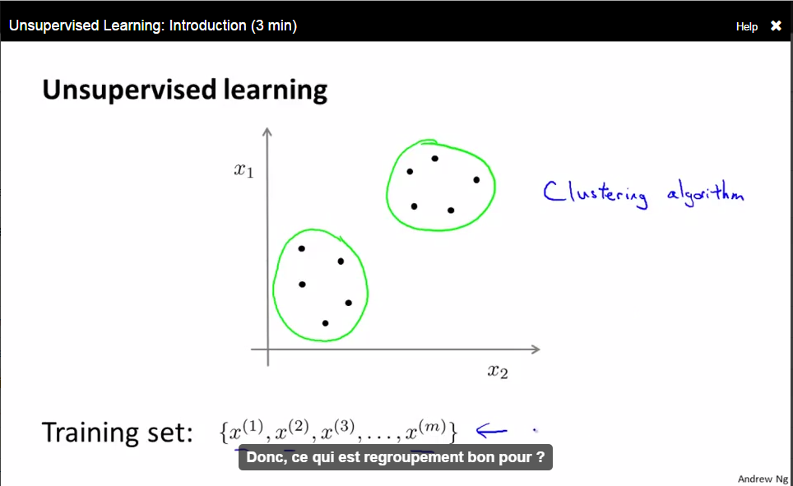

Slide 13
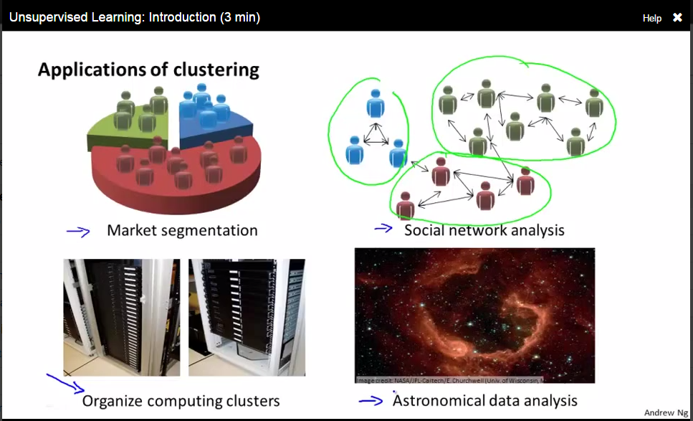

Slide 14
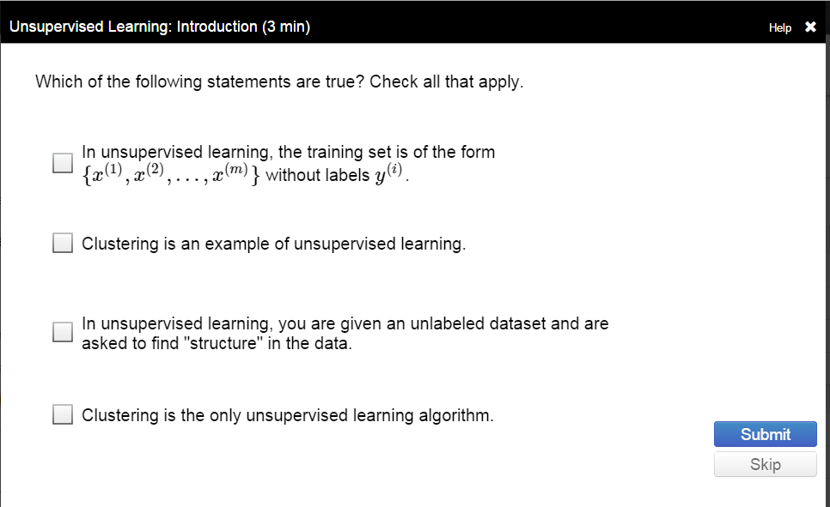

Slide 15
Think 2
A computer program is said to learn from experience E
with respect to some task T and some performance measure P,
if its performance on T, as measured by P, improves with experience E.
Suppose your house has been entered by unknown person, you wish to monitor remotely. You installed CCTV and created a face filter . What would be your task T in this setting ?
Tagging familiar and non-familiar faces
Fraction of correctly recognized familiar or non familiar faces
Classifying faces through setting switch on or off alarm

Slide 16
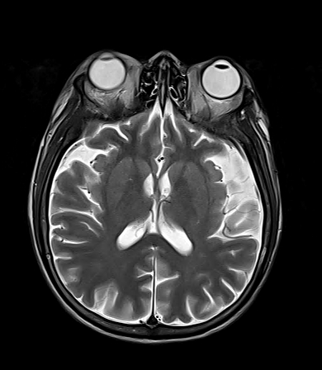
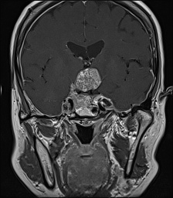
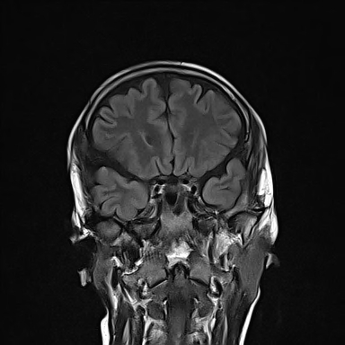
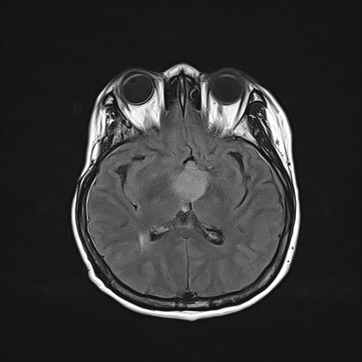
Lets guess, which are normal brain images?

Slide 17
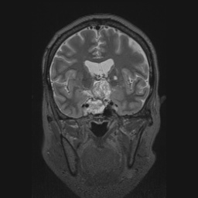
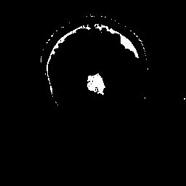
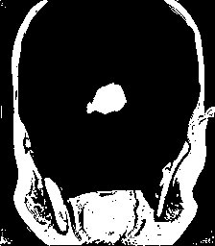
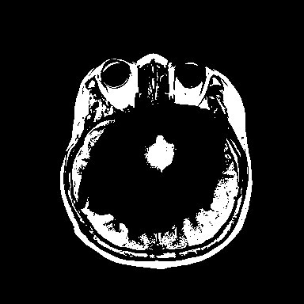
Guess how can you learn?

Slide 18
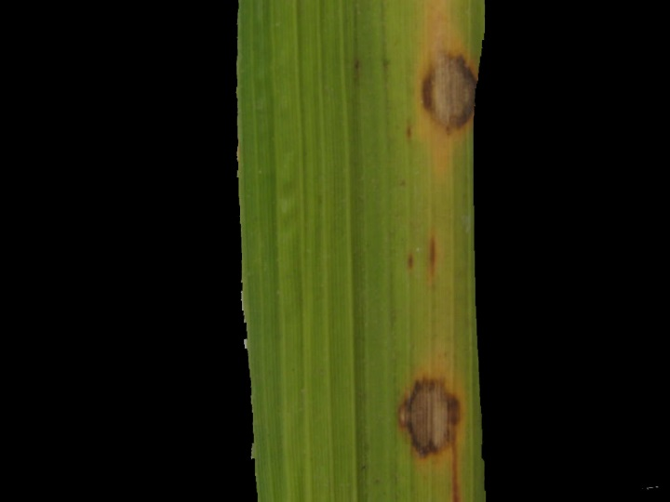
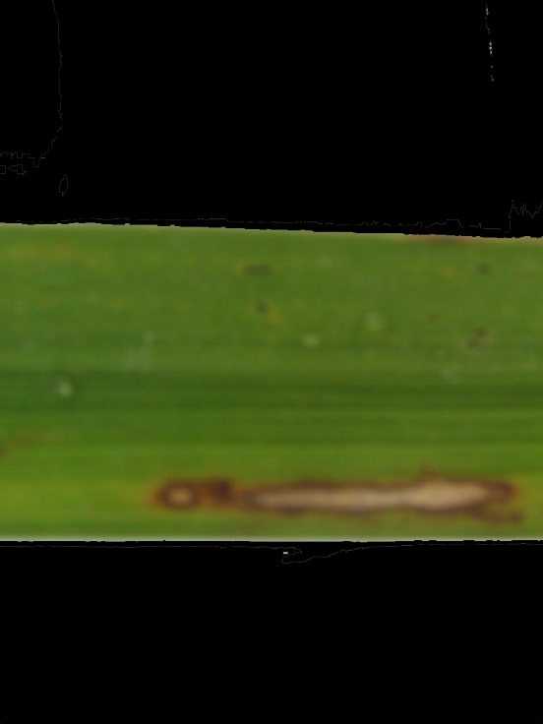
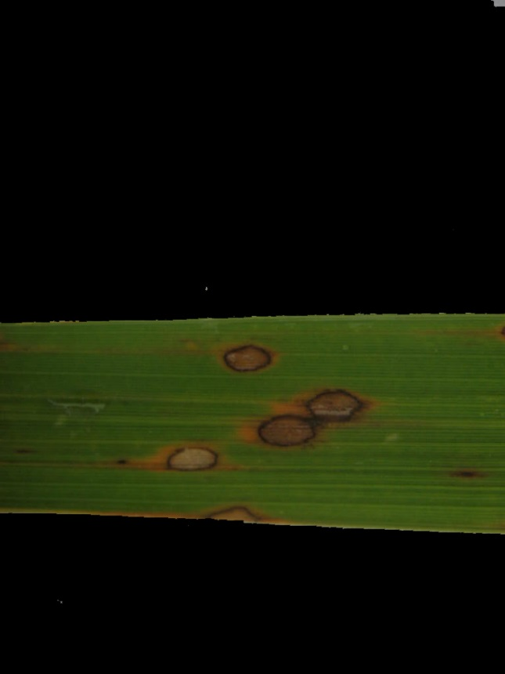
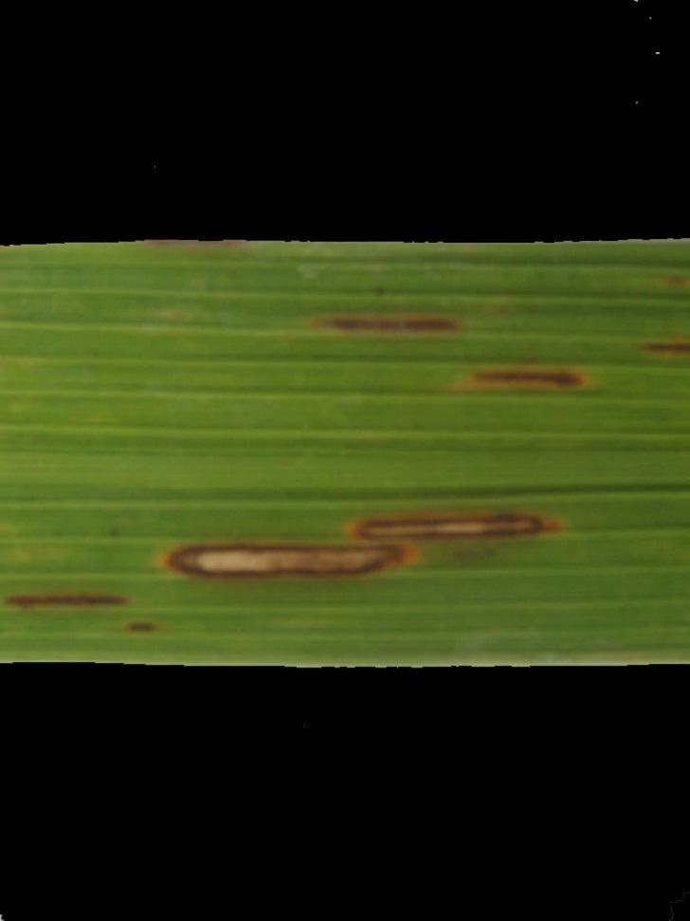
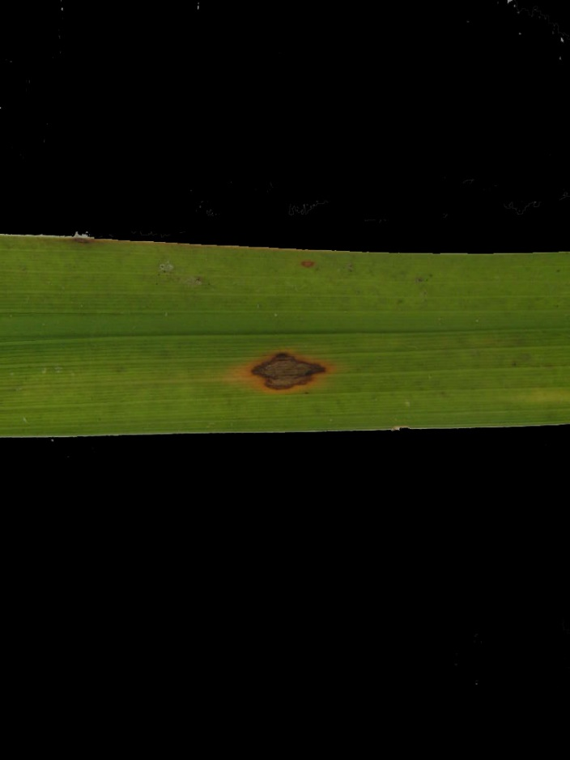
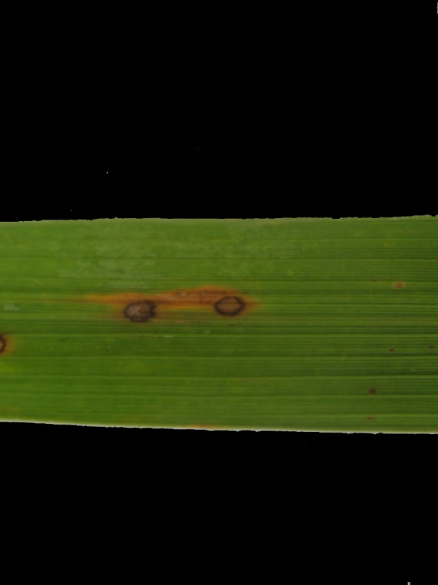

Slide 19
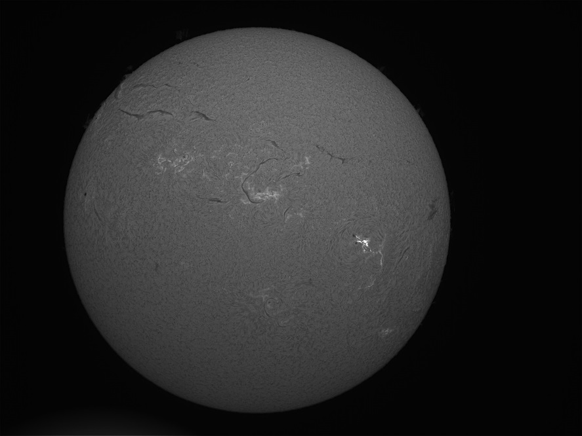

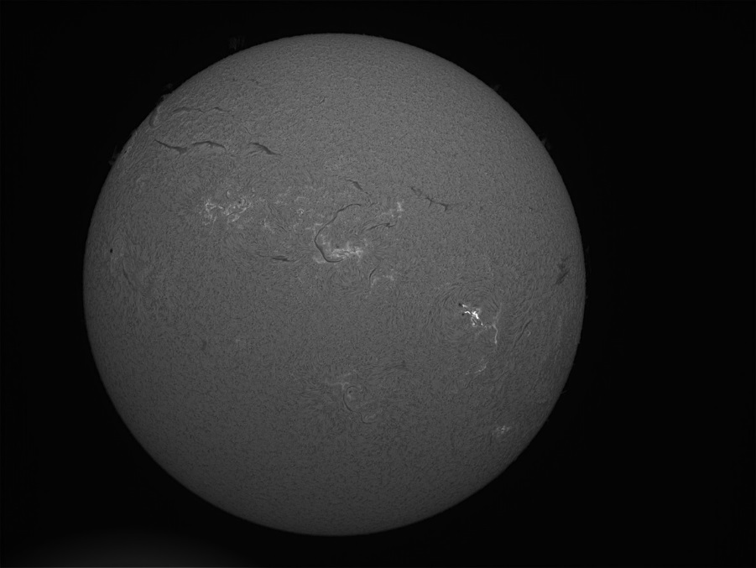
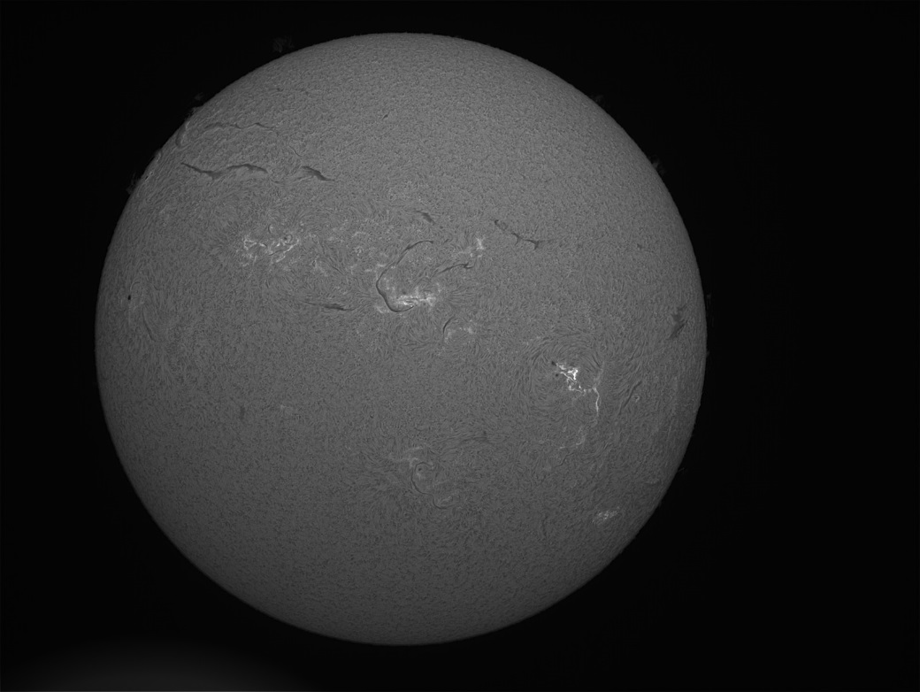

Slide 20
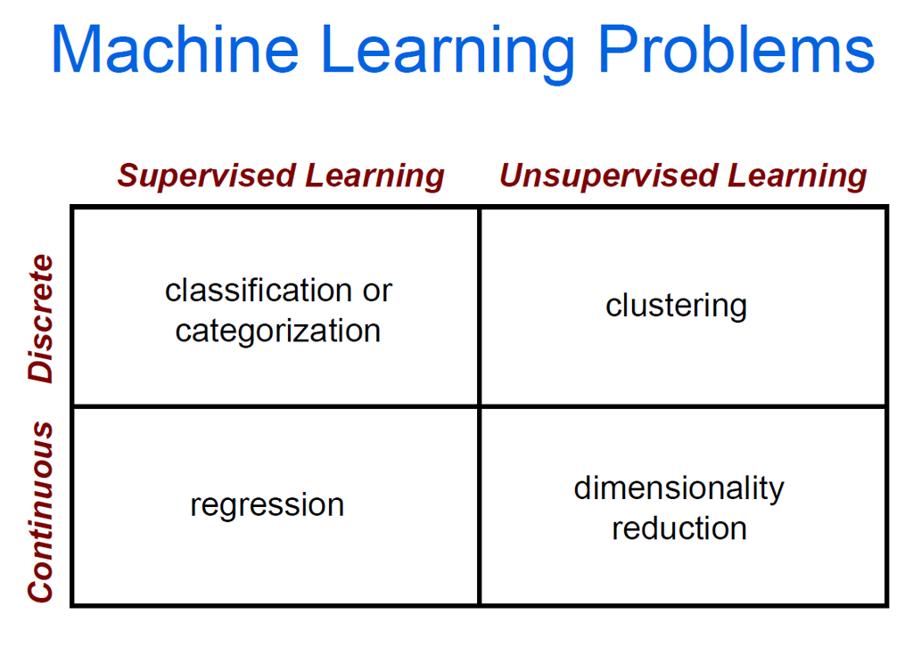

Slide 21
Clustering Strategies
K-means
Iteratively re-assign points to the nearest cluster center
Agglomerative clustering
Start with each point as its own cluster and iteratively merge the closest clusters
Mean-shift clustering
Estimate modes of pdf
Spectral clustering
Split the nodes in a graph based on assigned links with similarity weights
As we go down this chart, the clustering strategies have more tendency to transitively group points even if they are not nearby in feature space

Slide 23
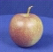
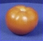
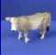
The machine learning framework
Apply a prediction function to a feature representation of the image to get the desired output:
f( ) = “apple”
f( ) = “tomato”
f( ) = “cow”
Slide credit: L. Lazebnik

Slide 24
The machine learning framework
y = f(x)
Training: given a training set of labeled examples {(x₁,y₁), …, (x_{N},y_{N})}, estimate the prediction function f by minimizing the prediction error on the training set
Testing: apply f to a never before seen test example x and output the predicted value y = f(x)
output
prediction function
Image feature
Slide credit: L. Lazebnik

Slide 25

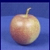
Steps
Training
Training Labels
Training Images
Image Features
Training
Learned model
Testing
Image Features
Learned model
Prediction
Test Image
Slide credit: D. Hoiem and L. Lazebnik

Slide 26

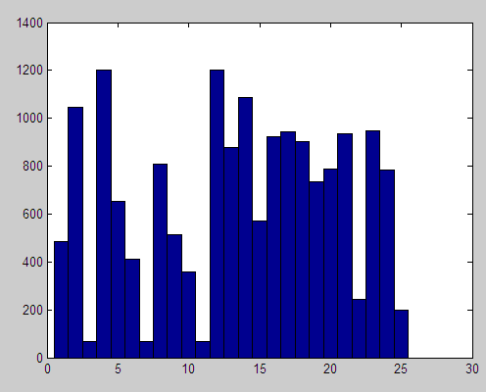

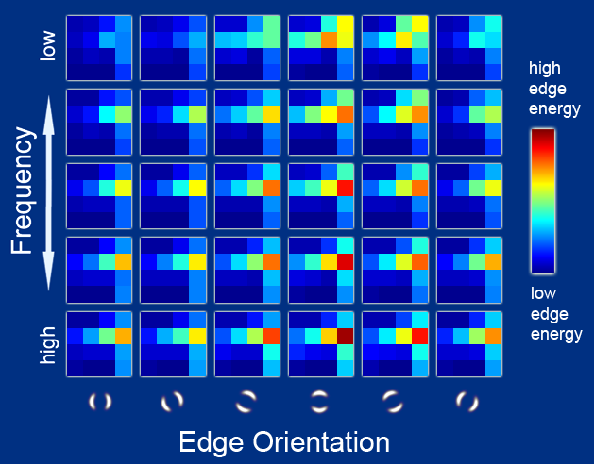
Features
Raw pixels
Histograms
GIST descriptors
…
Slide credit: L. Lazebnik

Slide 27
Classifiers: Nearest neighbor
Test example
Training examples from class 2
Training examples from class 1
f(x) = label of the training example nearest to x
All we need is a distance function for our inputs
No training required!
Slide credit: L. Lazebnik

Slide 28
Classifiers: Linear
Find a linear function to separate the classes:
f(x) = sgn(w ⋅ x + b)
Slide credit: L. Lazebnik

Slide 29
Many classifiers to choose from
Which is the best one?
SVM
Neural networks
Naïve Bayes
Bayesian network
Logistic regression
Randomized Forests
Boosted Decision Trees
K-nearest neighbor
RBMs
Etc.
Slide credit: D. Hoiem

Slide 30

Recognition task and supervision
Images in the training set must be annotated with the “correct answer” that the model is expected to produce
Contains a motorbike
Slide credit: L. Lazebnik

Slide 31
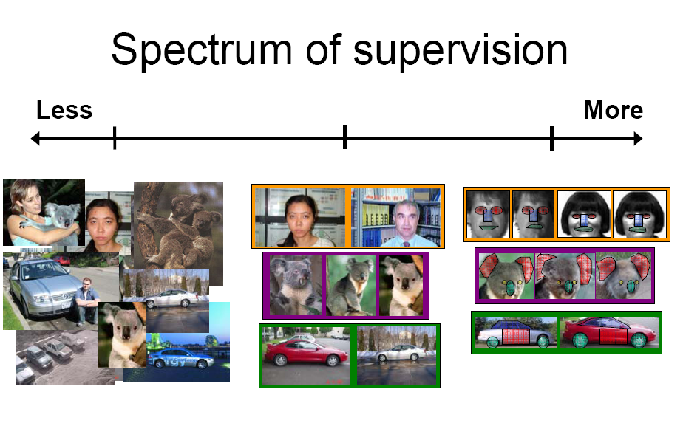
Unsupervised
“Weakly” supervised
Fully supervised
Definition depends on task
Slide credit: L. Lazebnik

Slide 32
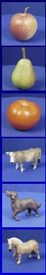
Generalization
Training set (labels known)
Test set (labels unknown)
How well does a learned model generalize from the data it was trained on to a new test set?
Slide credit: L. Lazebnik

Slide 33
Generalization
Components of generalization error
Bias: how much the average model over all training sets differ from the true model?
Error due to inaccurate assumptions/simplifications made by the model
Variance: how much models estimated from different training sets differ from each other
Underfitting: model is too “simple” to represent all the relevant class characteristics
High bias and low variance
High training error and high test error
Overfitting: model is too “complex” and fits irrelevant characteristics (noise) in the data
Low bias and high variance
Low training error and high test error
Slide credit: L. Lazebnik

Slide 34
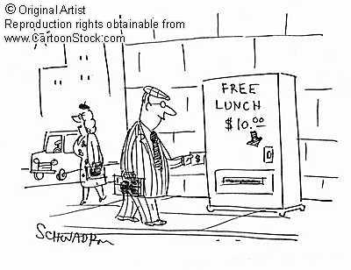
No Free Lunch Theorem
Slide credit: D. Hoiem
Notes:
You can only get generalization through assumptions.

Slide 35
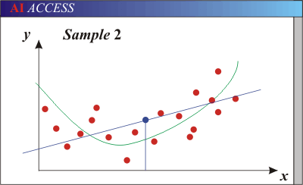
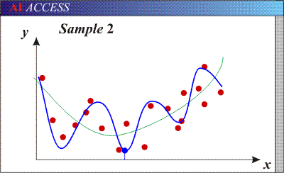
Bias-Variance Trade-off
Models with too few parameters are inaccurate because of a large bias (not enough flexibility).
Models with too many parameters are inaccurate because of a large variance (too much sensitivity to the sample).
Slide credit: D. Hoiem
Notes:
http://www.aiaccess.net/English/Glossaries/GlosMod/e_gm_bias_variance.htm

Slide 36
Bias-Variance Trade-off
E(MSE) = noise² + bias² + variance
Error due to variance of training samples
Unavoidable error
Error due to incorrect assumptions
See the following for explanations of bias-variance (also Bishop’s “Neural Networks” book):
http://www.inf.ed.ac.uk/teaching/courses/mlsc/Notes/Lecture4/BiasVariance.pdf
Slide credit: D. Hoiem
Notes:
From the link above:
You can only get generalization through assumptions.
Thus in order to minimize the MSE, we need to minimize both
the bias and the variance. However, this is not trivial to do this. For instance, just
neglecting the input data and predicting the output somehow (e.g., just a constant), would definitely minimize the variance of our predictions: they would be
always the same, thus the variance would be zero—but the bias of our estimate
(i.e., the amount we are off the real function) would be tremendously large. On
the other hand, the neural network could perfectly interpolate the training data,
i.e., it predict y=t for every data point. This will make the bias term vanish entirely, since the E(y)=f (insert this above into the squared bias term to verify this),
but the variance term will become equal to the variance of the noise, which may
be significant (see also Bishop Chapter 9 and the Geman et al. Paper). In general,
finding an optimal bias-variance tradeoff is hard, but acceptable solutions can be
found, e.g., by means of cross validation or regularization.

Slide 37
Bias-variance tradeoff
Underfitting
Overfitting
Error
Test error
Training error
High Bias
Low Variance
Complexity
Low Bias
High Variance
Slide credit: D. Hoiem

Slide 38
Bias-variance tradeoff
Few training examples
Test Error
Many training examples
High Bias
Low Variance
Complexity
Low Bias
High Variance
Slide credit: D. Hoiem
Notes:
Note: these figures don’t work in pdf

Slide 39
Effect of Training Size
Fixed prediction model
Error
Testing
Generalization Error
Training
Number of Training Examples
Slide credit: D. Hoiem

Slide 40
The perfect classification algorithm
Objective function: encodes the right loss for the problem
Parameterization: makes assumptions that fit the problem
Regularization: right level of regularization for amount of training data
Training algorithm: can find parameters that maximize objective on training set
Inference algorithm: can solve for objective function in evaluation
Slide credit: D. Hoiem

Slide 41
Introduction to Artificial Neural Networks

Slide 42
Neural Computations
Refers to computation with artificial neurons
These artificial neurons are very crude approximations to real neurons in the brain
The goal here is not to make a good model for real neurons, but to compute with artificial neurons
But maybe artificial neurons modeled more closely after real neurons could be better??? We don’t know.
It is, of course, a valid quest to model real neurons more closely just for the sake of understanding real neurons.

Slide 43
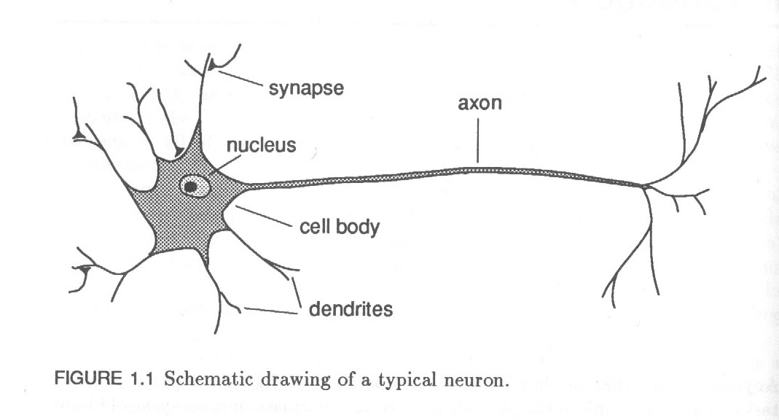
Real Neurons
Brain has about 10¹¹ neurons (nerve cells) of many different types
Fig. 1.1 shows a “representative” neuron.
Tree-like networks of nerve fibers called dendrites are connected to the cell body or soma
Soma has cell nucleus
Extending from soma is a single long fiber called the axon
Axon eventually branches or arborizes into strands and substrands
At the ends of these strands are the transmitting ends of the synaptic junctions, or synapses to other neurons
The receiving ends of these junctions on other cells can be found both on the dendrites and on the cell bodies themselves.
The axon of a typical neuron makes a few thousand synapses with other neurons!

Slide 44
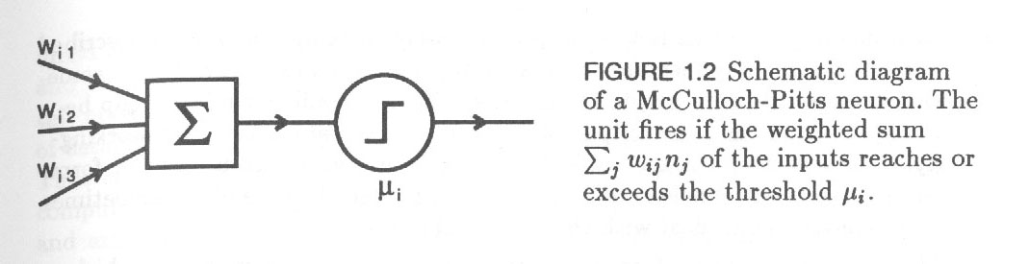
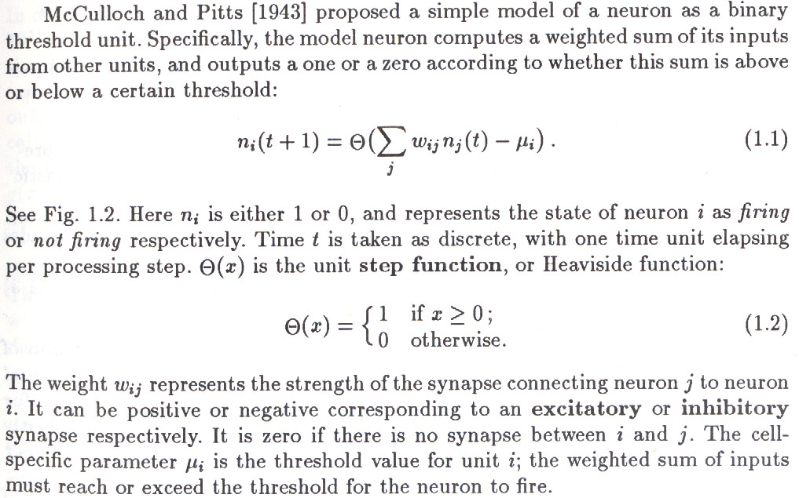
Pitts-McCulloch Neuron

Slide 45
More on the Pitts-McCulloch Neuron
Though simple, this neuron is a computationally very powerful device
They proved that a synchronous assembly of such neurons is capable of universal computation for suitably chosen weights
Can compute any Boolean function
This proof is not hard and is both books cited on the title slide. (See Zurada, p. 30.)
This means that it can compute anything a Turing Machine (or any digital computer) can.
However, neural nets are more useful for approximating continuous functions than for computing Boolean functions!

Slide 46
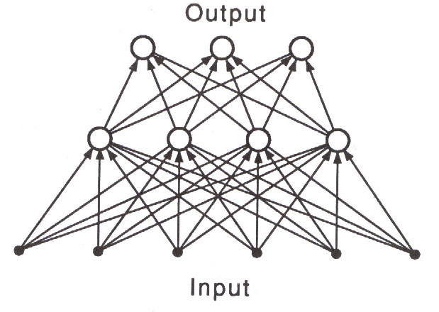
Perceptrons: Multilayer Perceptrons
Applications:
approximation of any function!
Modeling
Classification
Prediction
Control

Slide 47
History
History of “these sorts of ideas in psychology” originated with Aristotle
Yet as a basis for computational or neural modeling we can trace these ideas to Pitts and McCulloch, or McCulloch and Pitts (1943).
Pitts was a very unusual character, and probably the true inventor of the artificial neuron model. I have a friend who knew him, and will tell you what I remembered he told me in class.
For more on McCulloch and Pitts, see
http://soma.crl.mcmaster.ca/~zhechen/scientists_1.htm
(not very informative about Pitts, though)

Slide 48
History, page 2
As I said before, the first results were positive – one could compute anything computable using these nets
Around 1960, Rosenblatt and his group concentrated on how to find appropriate weights for the perceptron to compute particular things.
Their work was more successful on one-layer perceptrons.
They found an algorithm for training (finding the weights and threshold for) one-layer perceptrons.
Algorithm is called the “perceptron rule.”
Unfortunately one-layer perceptrons can’t compute very much.
Rosenblatt also worked on multilayer perceptrons, but didn’t find a way to train them.

Slide 49
History, page 3
Minski and Pappert (1967) showed that even a simple function like the XOR of 2 variables can’t be computed by a single-layer perceptron. (A trivial result, no doubt.)
They also express their opinion that no algorithm would ever be found to train multilayer perceptrons with.
In conclusion, Minski and Pappert state:
One layer perceptrons may be trainable by Rosenblatt’s method, but they are not very useful
Multilayer perceptrons have been shown to be useful if only they could be trained, but it’s their opinion that they probably couldn’t be trained!
This shut down most of neural networks (perceptron) research in the decade that follows.

Slide 50
History, page 4
Other things came out, some related to physics and some to associative memory (content-addressable memory), but I don’t know much about them, so I’ll ignore them for now and concentrate on perceptrons for classification.
In 1974, Werbos seemed to be the first to figure out how to train multilevel perceptron in the context of business math tools. That proved Minski and Pappert wrong.
This result was rediscovered again and again in the mid 80’s.
The algorithm came to be known as “backpropagation” (gradient descent) and it works pretty well on training multilayer perceptrons.
Some people insist that backprop only refers to propagating the error backwards through the network

Slide 51
History, page 5
However, it sometimes doesn’t converge!! (convergence rate is up to 60-70% for hard classification problems.)
There are improvements on backprop, but their convergence rates aren’t better
Except algorithms that build networks, those can converge all the time
Our new algorithm converges all the time so far.

